Slide 1

Mid Term Presentation
Combined Capstone
Design 2
4th group
2021. 04. 20

Slide 2
Table of Contents
1. Definition of the problem
2. Problem solution
3. Process of the project
4. Indicator to evaluate result
4th Group

Slide 3
Definition of the problem

Slide 4
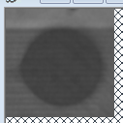

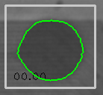
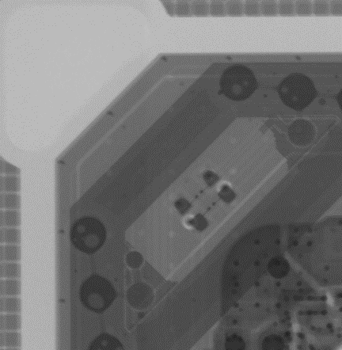
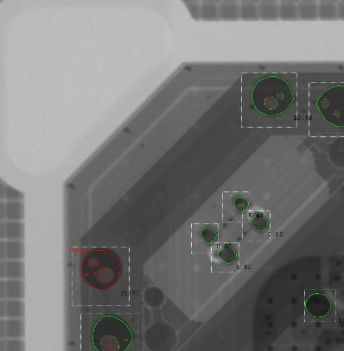
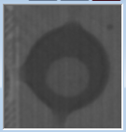

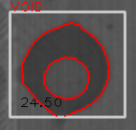
1. Definition of the problem
Inspection failure of solder void cause bad influence to product yields.
Most important process in inspection is segmentation and detection of objects.
Ideal inspection process
object
Inspection result
Object detection and segmentation
4th Group

Slide 5



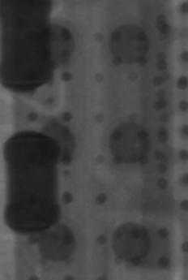
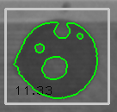

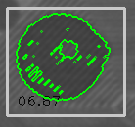
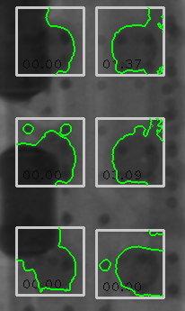
1. Definition of the problem
However… it is impossible to inspect all images ideally, although there are many kinds of segmentation algorithms.
Level of programming difficulty increase when we handle images especially like X-Ray images that have bad contrast or unexpected noises.
Segmentation using simple intensity thresholding method
4th Group

Slide 6
Problem solution

Slide 7
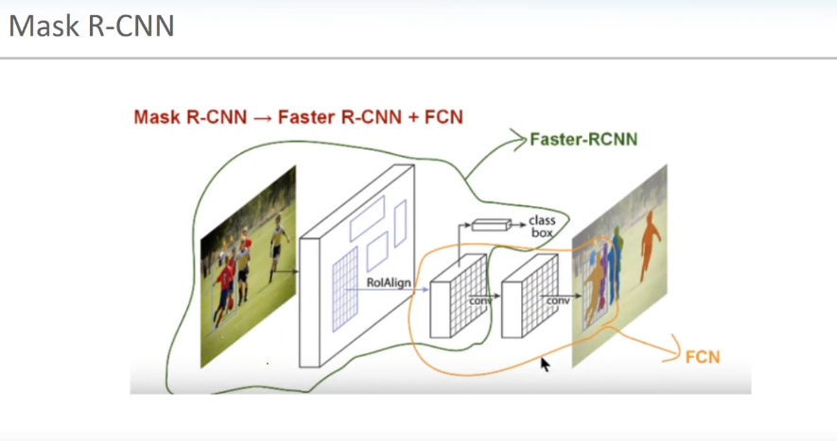
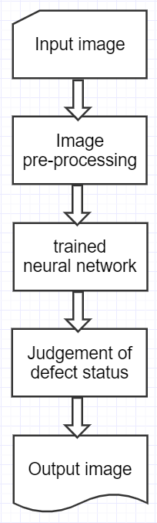
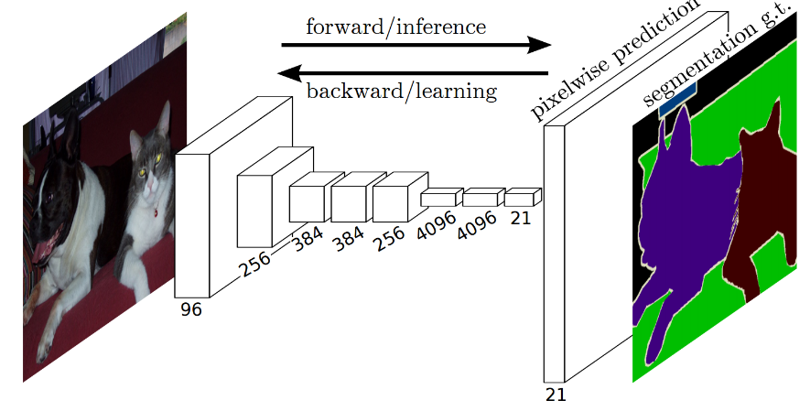
2. Problem solution
We intend to solve object segmentation problem using deep learning.
Structure of Mask R-CNN
Inspection process using deep learning
Operation principle of Mask R-CNN
4th Group

Slide 8
Process of project

Slide 9
3. Process of project
Training model hyper parameter
parameter | Value
Classification Loss | Multiclass cross-entropy (default)
Mask Loss | Binary cross-entropy (default)
Loss rate | 0.001
Epoch | 100
Batch size | 10
Weights init type | Transfer learning
Number of image data | 5489
Train and validation data ratio | 7:3
Data augmentation method | Crop
4th Group

Slide 10


3. Process of project
Training environment
Environment specification
Item | specification
AMI(composition of SW) | Deep Learning AMI (Amazon Linux 2) Version 43.0
Instance | p3.2xlarge
4th Group

Slide 11

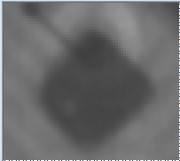
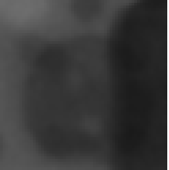
3. Process of project
We intend to compare inspection performance between these two inference model.
1) inference model trained with raw image dataset.
Raw image dataset
Train
Mask R-CNN
Inference
model
………
Model
Weights
4th Group

Slide 12

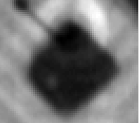
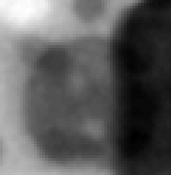
3. Process of project
2) inference model trained with pre-processed image dataset.
Histogram stretching
(Contrast Enhancement)
Train
Mask R-CNN
Inference
model
Model
Weights
4th Group

Slide 13
Indicator to evaluate result

Slide 14
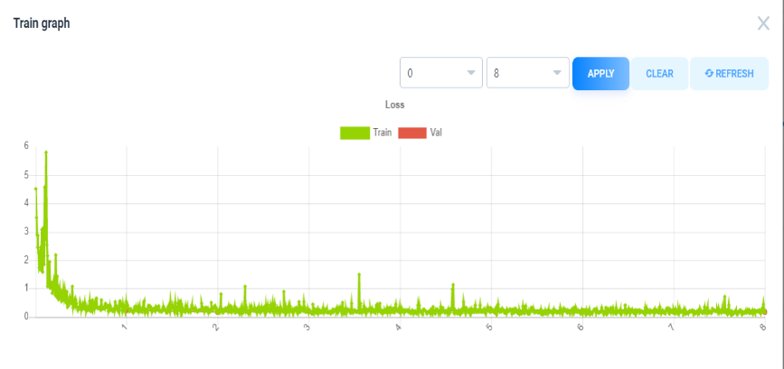
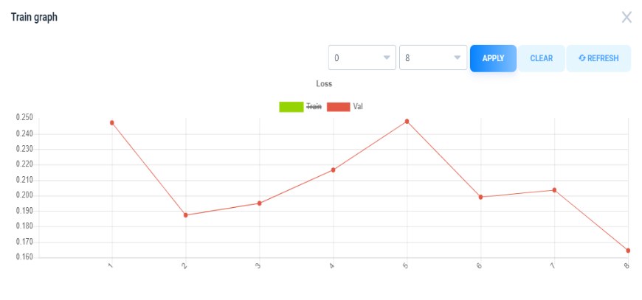
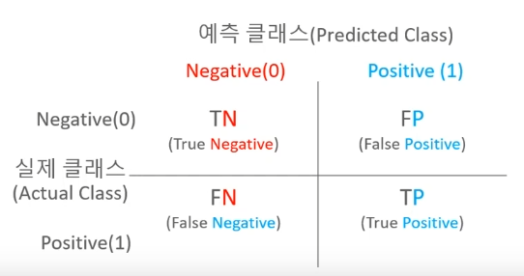
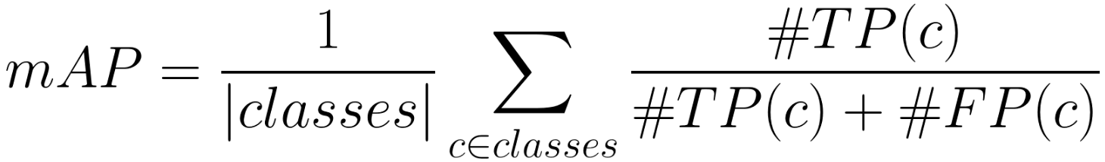
4. Indicator to evaluate result
How to evaluate inspection performance of inference model?
1) Train loss and Validation loss
2) mAP(mean Average Precision)
4th Group

Slide 15
4. Indicator to evaluate result
Test using mAP
- Use selected 400 images dataset for mAP test.
- Calculate mAP for confidence threshold of 0.75 , 0.5
Compare inspection performance of inference model using train, validation loss and mAP
4th Group

Slide 16
Reference
1. 컴퓨터 비전 완벽 가이드, 인프런
2. supervisely.ly
4th Group

